Slide 1
Measuring Stars
Year 10 Pre-ATAR Science

Slide 2
Review
What is the difference between a planet and a star?
Why do we study the universe?
What are some of the challenges of studying the universe?

Slide 3
Learning Intention
The universe contains features including galaxies, stars and solar systems and the Big Bang theory can be used to explain the origin of the universe

Slide 4
Success criteria
Explain how to measure distance of stars using parallax trigonometry.
Use Hertzsprung-Russell diagrams to find information about absolute magnitude, colour and use this to classify stars
Describe main sequence, red giant, supergiant, supernovae, neutron stars and black holes.

Slide 5
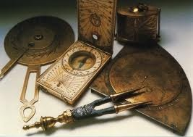
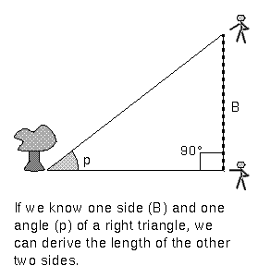
How do we measure distance of stars?

Slide 6
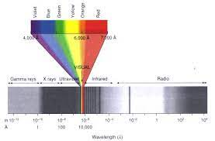
Why are stars different colours?

Slide 7
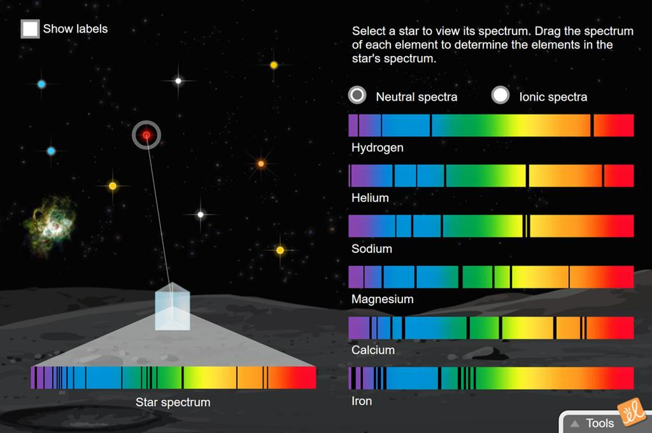

Slide 8
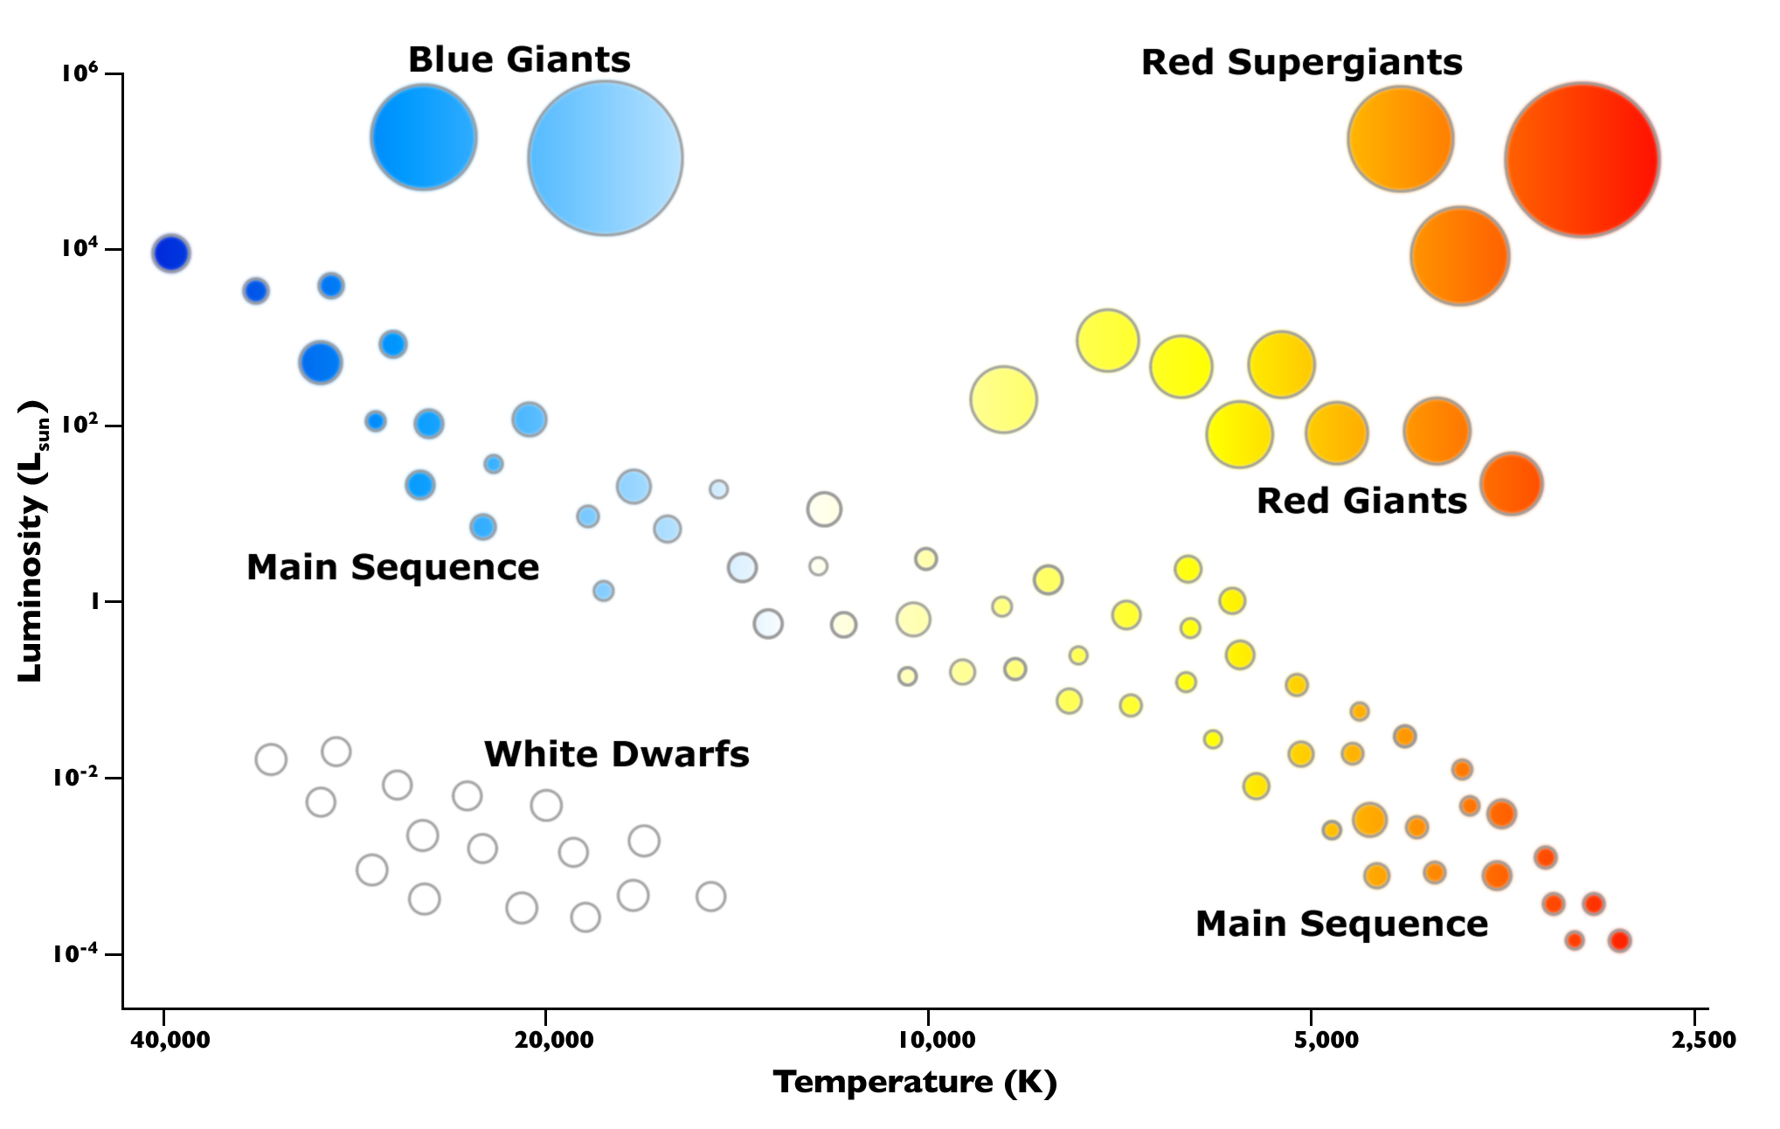

Slide 9
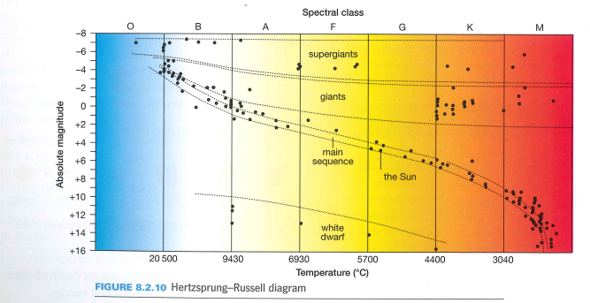

Slide 10
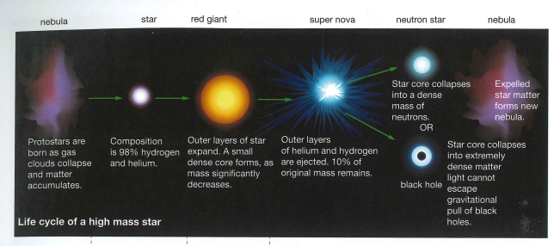

Slide 11
